Slide 1

Evaluating Factuality in Text Simplification
CSCI 544 – Applied Natural Language Processing
Paper Presentation
Group 31

Slide 2
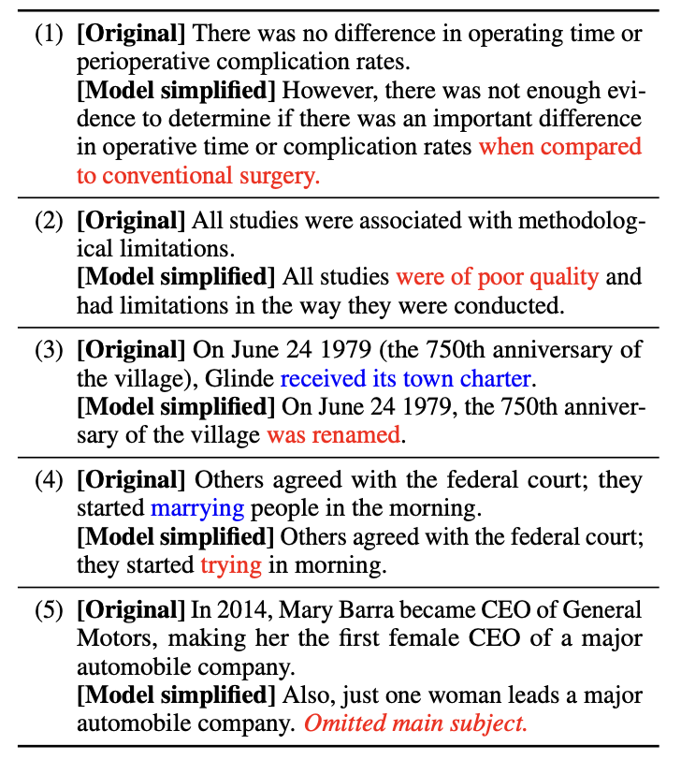
Introduction
Automated simplification models aim to make texts easier to read. These models could benefit non-native speakers, children, and people with aphasia or dyslexia.
However, such models risk introducing errors into automatically simplified texts such as adding unsupported information or omitting key details.
In this paper, the authors introduce a taxonomy of errors that we use to analyze both references drawn from standard simplification datasets and state-of-the-art model outputs and conclude that these errors are not captured by existing evaluation metrics.
Table: Original texts from the Wiki, news, and medical domains with corresponding outputs from simplification systems.

Slide 3
Related Works
Laban et al. (2021): Highlighted the importance of factuality in unsupervised simplification.
Devaraj et al. (2021): Emphasized the role of factuality in medical simplification.
Guo et al. (2018): Incorporated textual entailment to improve simplifications, but did not explicitly evaluate factuality.
Falke et al. (2019a): Proposed using textual entailment predictions to identify errors in summaries, which could be a for assessing factuality in simplifications.
Kryscinski et al. (2020a): Used weak supervision to intentionally introduce factual errors and train a model to identify inaccuracies in outputs, offering insights into factuality evaluation.
Maynez et al. (2020): Evaluated hallucinations in automatically generated outputs, suggesting that ROUGE is a weak gauge of factuality.
Wang et al. (2020a): Proposed QAGS, which uses automated question-answering to measure consistency between reference and generated summaries, potentially applicable to factuality evaluation.
Pagnoni et al. (2021): Introduced FRANK, a benchmark for evaluating factuality metrics for summarization, which could be adapted for simplification evaluation.

Slide 4
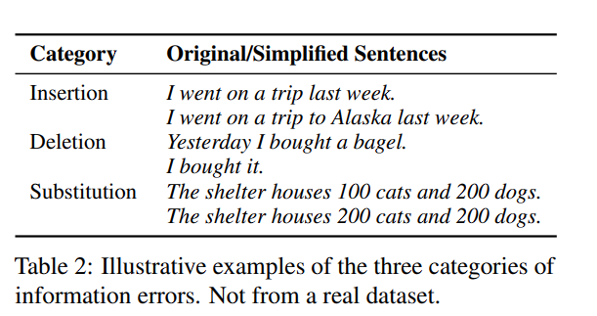
Information Errors in Simplification
The paper aims to codify content errors in simplification. There are 3 broad categories of errors:
Information Insertion: It occurs when information not mentioned in the complex sentence is inserted into or hallucinated in its simplified counterpart.
Information Deletion: It occurs when information in the complex sentence is omitted from the simplified sentence.
Information Substitution: It occurs when information in the complex sentence is modified in the simplified sentence such that it changes the meaning.
Here is an example of each error type:

Slide 5
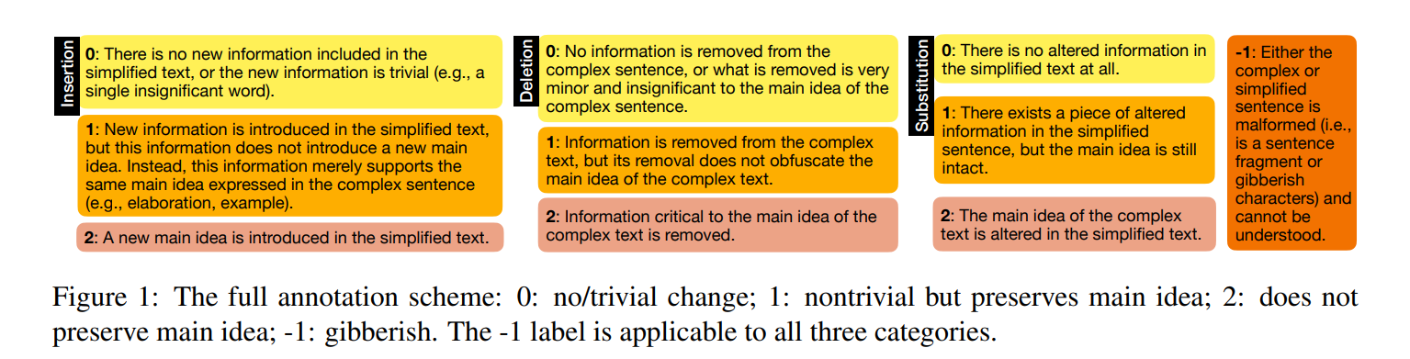
Information Errors in Simplification
The error categories defined earlier can be interpreted as errors in information
Precision: The fraction of content that also appears in the complex sentence
Recall :The fraction of content in the complex sentence preserved during simplification
A “False Positive” (affecting precision) occurs when the simplified sentence contains information not present in the source, i.e., introduces a “hallucination”.
A “False Negative” (hindering recall) is where the simplified sentence omits key information in the source.

Slide 6
Dataset and Models
Dataset:
The paper focuses on the simplest level in Newsela, annotating 400 pairs for validation and test sets each. For Wikilarge, we annotate 400 pairs from the validation set and 359 from the test set, covering the entire test set.
Models:
RNN-based models
Dress is an LSTM model trained using REINFORCE to minimize a reward function consisting of meaning preservation, simplicity, and fluency terms.
EditNTS represents each sentence pair as a sequence of edit operations and directly learns these operations to perform simplification.
Transformer-based Model:
Access trains a randomly initialized Transformer to generate simplifications parametrized by control tokens influencing traits like lexical complexity and length compression.
ControlTS is a hybrid method that generates simplification candidates using grammatical rules and then applies a BERT-based paraphrasing model.
A fine-tuned T5:
T5 is a Transformer-based model jointly pretrained both on unsupervised language modeling objectives and a host of supervised tasks including summarization and translation, all framed as text-to-text problems

Slide 7
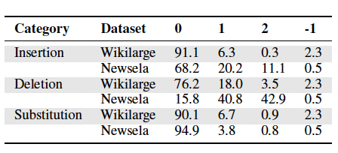
Labeling with Mechanical TURK
Acquired labels for reference examples from datasets and model-generated simplifications.
For each category - insertion, deletion, substitution - the final label was determined by the majority vote from annotators.
Degree of inter-annotator agreement was quantified using 3 metrics:
Percentage of examples that had a well-defined majority label for each category
Percentage of examples with majority non-zero annotations that also have a well-defined majority label.
Krippendorff’s alpha with an ordinal level of measurement
Metrics captured different aspects of labeling consistency.
Table: Insertion, deletion, and substitution error distributions (%)

Slide 8
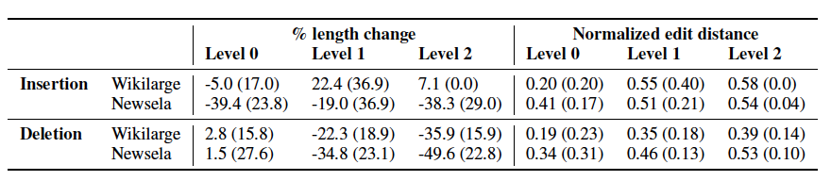
Factuality of Reference Examples
Quantitative Analysis
Deletion errors are far more common than insertion errors in both datasets.
There is a clear positive correlation between length reduction and the severity of deletion errors present.
The normalized edit distance between the original and simplified sentences is greater when the insertion or deletion is more erroneous.
Qualitative Analysis
Deletion Error Patterns: Label 1 involves omitting nonsalient details, while Label 2 often includes the deletion of the main clause, promoting a secondary clause, or removing a key phrase reframing the sentence.
Insertion Error Trends: In Newsela, both levels 1 and 2 of insertions show trends, including the addition of quotative phrases and temporal expressions, sometimes altering the original context.
Table: Insertion, deletion, and substitution error distributions (%)
Table: % length change and normalized edit distances in simplified sentence

Slide 9
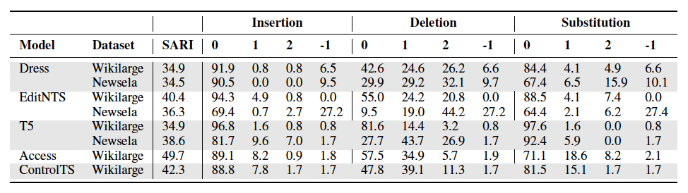
Factuality of System Outputs
RNN models exhibit milder deletion errors on Newsela but amplified errors on Wikilarge.
T5 model outputs show rare -1 errors, highlighting more apparent differences in insertion errors.
Dress and T5, demonstrate higher rates of substitution errors in Newsela outputs compared to Wikilarge, despite dataset differences.
Transformer models, including T5 and Access, demonstrate significantly fewer gibberish errors (-1 errors) compared to RNN-based models.
Mean edit distances increase with the severity of deletion errors, with no consistent trends found for insertion and substitution labels.
RNN models primarily exhibit shorter deletion errors at level 1, while longer deletions are observed at level 2, suggesting adherence to syntactic rules.
There's variability in error types introduced by Transformer models, with no clear patterns based on model type observed for insertion and substitution errors.
Table: SARI and error distributions in system outputs manually evaluated.

Slide 10
Comparison with Existing Metrics
SARI is commonly used to evaluate text simplification models but shows only a weak correlation with the prevalence of information errors.
Various semantic similarity measures, such as Jaccard similarity and cosine similarity between embeddings, are explored to detect information errors.
These measures effectively capture deletion errors but show moderate to weak indication for insertion and substitution errors.
FACT-CC and DAE outputs correlate less with insertion and deletion annotations compared to surface-level semantic similarity measures.
DAE scores show better correlation with substitution errors compared to FACT-CC and other semantic similarity measures.

Slide 11
Automatic Factuality Assessment
Manual annotation is costly and time-consuming, so the authors attempted to automate factuality assessment by training a model on human annotations and exploring methods of generating synthetic data to improve model performance.
The authors framed automatic factuality assessment as a classification task, with a separate classifier trained for each category (Insertion, Deletion, and Substitution), for each of the levels 0, 1, and 2.
To alleviate the issue of a small and highly imbalanced validation dataset, the authors experimented with generating synthetic insertion and substitution errors on which to pretrain the model.
The deletion classifier achieved the best F1 scores, likely due to the fact that the training dataset had plenty of level 1 and 2 deletion errors.
Using synthetic data was useful in improving performance, but detecting errors remained a challenging task.

Slide 12
Conclusion
The study evaluated the factuality of automated simplification corpora and model outputs using an error typology.
Deletion errors were found to be frequent in the datasets, and the models also tend to delete information.
Factuality errors extend beyond sentence-level datasets and are present in other domains like medical text simplification.
Existing metrics used in simplification like SARI poorly capture insertion or substitution errors, and automatic factuality assessment is a challenging task.

